Slide 1
Speculative Fiction Activity!

Slide 2
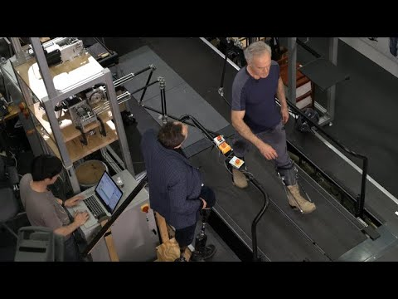

Slide 3


Slide 4
AlterEgo
By Blakeley H. Payne

Slide 5
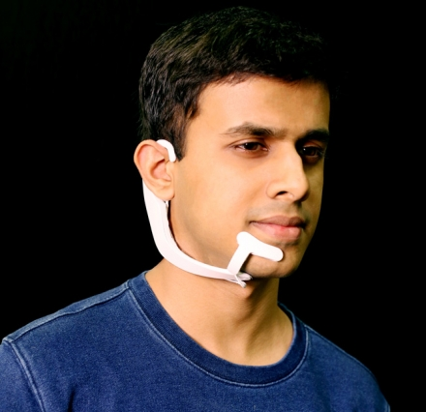
AlterEgo
AlterEgo is a wearable headset that allows you to “talk” to your devices, such as your a search engine on your phone or simply by thinking.

Slide 6
In 50 years this technology could do the most good by…
People who can’t speak will be able to communicate with their friends and family
People who speak different languages can communicate by having their thoughts translated on apps
Help us communicate with our pets and animals in general!
Therefore… People would probably eat less meat → great for climate change!

Slide 7
In 50 years this technology could do the most harm by…
Parents could monitor their children’s thoughts
Governments could monitor their citizens’ thoughts and unfairly imprison them if they don’t like those thoughts
The headset maker could sell your thought-data to advertisers and whenever you drive by a fast food place it plays an ad in your head about the food
Therefore… People would probably eat more red meat → very bad for climate change!

